Slide 1


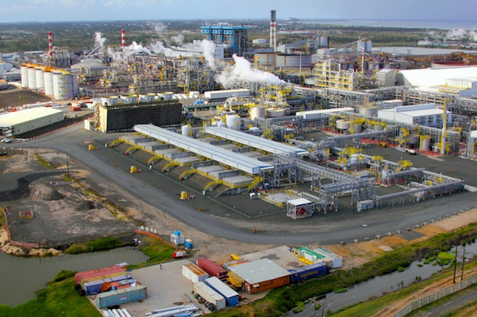
Mining and Minerals | Nickel Processing
Client Background
Key Challenges
The client is a leading producer of Nickel and Cobalt in Africa and one of the largest Nickel producers in the world. The company produces fully refined Nickel through a complex chemical recovery process.
The operation of a complex chemical processing facility in a remote African location poses real challenges associated with the availability of skilled resources. The extensive use of Expatriate resources result in a lack of standardised approach towards key business processes.
By partnering with Pragma for the improvement of its Asset Management practices, the company ensured the implementation of a standardised approach and proven processes to enhance its defect elimination program.
.
Lack of a structured approach towards problem solving and defect elimination.
Inability to identify the root cause of failures and prevent recurrence.
Inability to drive improvement actions to completion and demonstrate value add.
The workforce required knowledge and skills upliftment in the area of reliability.
Access to theoretical and on-the-job training interventions, coaching and mentoring was a challenge.
Value Add
The replacement of all previously welded shafts was recommended together with a design improvement related to the shaft machining to improve future shaft life.
A process was established for the serialisation and management of agitator shafts to monitor and optimise the full life performance of all agitator shafts.
A condition based monitoring programme was implemented to identify and keep track of at-risk shafts, bearing sleeves and mechanical seals.
Through an investment of approximately US$2,45million over six years and improved monitoring of agitator shafts, a benefit of US$1,95million in reduced risk to production loss can be derived every three years.
This equates to a Net benefit of US$242,000 on average per year.
By ensuring that the root cause of complex problems are identified, the organisation can effectively prevent the recurrence of problems.
Monitoring and control of improvement actions ensures that only effective solutions get entrenched to derive the maximum value
Pragma Intervention
Tools and Technology
The defect elimination program in use at the client was successful in solving simple issues but failed to eliminate the recurrence of more complex problems.
Pragma offered a multi faceted approach involving facilitated, on-site training courses plus an on site Reliability Engineering service, supplemented by a specialist Root Cause Analysis facilitator to solve the more complex problems.
A major recurring problem with significant risk to production related to the failure of Titanium agitator shafts. Pragma, working alongside the client Reliability Engineers, deployed a specialist RCA facilitator to site while the on-site Pragma Reliability Engineers assisted with data gathering and the validation of potential causes and improvement actions.
Through the Pragma Focused Improvement business process and Root Cause Analysis techniques, we identified the practice of weld repairs of Titanium shafts as the root cause of fatigue crack initiation and reduced fatigue life of the shafts.
Facilitated training courses and on the job coaching and mentoring of the client Reliability Engineers will ensure sustainability of the implemented solutions and processes.
Pragma Focused Improvement (FI) Business Process
DMAIC and IC problem solving techniques
A3 Project report
Structured Problem Solving Facilitated Training
Root Cause Analysis Facilitated Training
Reliability Engineering function as part of Asset Care Service

