Slide 1

Unlocking Value through Smarter
Spare Parts Management
The right parts, at the right time,
for the right results
A single missing spare part can halt production, disrupt operations, and damage client trust. Poor MRO (maintenance, repair and operations) spare parts management undermines uptime, inflates costs, and exposes businesses to unnecessary risk.
Key benefits
Concerns addressed
Predictable asset uptime - Maintenance is executed as planned, keeping critical assets available and productive.
Optimised working capital - Reduce spare parts inventory by 10 - 30% while maintaining or improving availability.
Operational efficiency - Structured stores and controlled processes eliminate waste and obsolete stock.
Reduced business risk – Less exposure to safety and compliance risk.
Improved cross-functional alignment - Operations, Maintenance, Procurement, and Finance work from a shared, consequence-based view of spares.
Downtime is expensive. One missing spare part can halt production, disrupt operations, and damage client trust.
Obsolete and excess stock ties up valuable capital.
Many organisations still struggle to manage their MRO inventory effectively.
Maintenance teams often wait for spare parts instead of performing scheduled work.
Emergency purchases and airfreight inflate costs.
Stores are packed with items, but the availability of the right spare part is still poor.
Finance and operations clash over appropriate stock levels.
Key features
A full set of services to give insight into the current maturity of the spares' function, the spares profile, the reporting and KPI’s used, as well as opportunities available.
An array of models/solutions to set the optimum spares levels.
Demand forecasting with peak filtering.
Monthly review and governance of stock parameters.
Support in setting optimum levels for new assets being commissioned and improving the processes.

Slide 2
Unlocking Value through Smarter Spare Parts Management
A complete solution set to gain insight into and optimise your spare parts services.
Our approach
Our approach combines Upfront assessment, Stock level optimisation, and Implementation support to help you gain clarity, set optimal stock levels, and sustain results.
We start by establishing a baseline on risk, demand drivers, performance, and waste to prioritise what to fix and where to focus. We then apply the right optimisation model to set service levels and inventory parameters based on consequence, behaviour, and cost. Finally, we embed the solution through process discipline, training, governing master data and level changes and continuous improvement initiatives.
Our offering is delivered across the three pillars below — choose one, or combine them for end-to-end impact.
Upfront assessment options
1
Spare Parts Maturity Assessment
2
MRO Spare Parts Profile and KPI Analysis
3
Spare Parts Opportunity
and Waste Analysis
Process and performance evaluation
Spares profile identification
Waste and improvement diagnosis
Confirm whether you’re doing the basics correctly.
Confirm the environment has the right reports and KPIs.
Identify where optimisation effort will deliver the most value.
Stock level optimisation options
1
Material Criticality Model
2
Value-based
Model
3
Complete Plant Simulation Model
Criticality-based service levels
Classification and per-item optimisation
RBD (reliability block diagram) modelling
Establish a reliable criticality profile and set differentiated service levels when spare parts data is limited or inconsistent.
Optimise each item by balancing holding cost against the probability and monetary consequence of a stock-out.
Extend RBD modelling to include maintenance plans and spare parts demand, best for complex systems or new plants where high accuracy is required.
Implementation support
Not a once-off exercise, a sustained optimisation discipline driven by risk and consequence
Store process and maturity improvement: embed standards, controls, and ways of working that sustain performance.
Onboarding support for new projects: spare parts identification, specification, optimisation, and codification during commissioning and expansions.
Continuous optimisation (to an economically sensible level): prioritised improvement based on the Opportunity and Waste Analysis and ongoing performance signals.
Govern and maintain master data (BoMs, task links, codification, and criticality): keeping CMMS/EAM and the material master aligned so optimisation remains reliable.

Slide 3


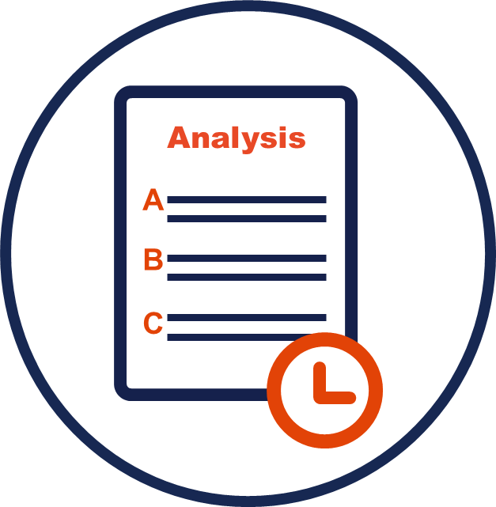
Unlocking Value through Smarter Upfront Assessment Options
Upfront assessment ensures effort is focused where it delivers the greatest value.
Effective spare parts optimisation starts with understanding the department’s process maturity, then the requirements, and finally expanding on the available improvement options. With this in hand, organisations avoid blanket optimisation by opting for a tailor-made prioritised path forward. The array of assessment options caters for that exact need.
Combinations of options, up to the entire assessment, may be valuable depending on the requirements and circumstances.
1
Spare Parts Maturity Assessment
Process and performance evaluation
Assesses 13 core MRO spare parts management processes across 63 structured verification points, covering people, processes, data, governance, and system enablement.
This gives insight as to whether the basic spare functions and processes are being done right.
Delivers a prioritised, phased improvement plan.
2
MRO Spare Parts Profile and KPI Analysis
Waste and improvement diagnosis
Data-driven review of stock value vs. demand across the spare parts portfolio.
This is used to motivate the optimization methodology to be used.
Reporting evaluation looks at the KPI’s which governs and directs the system. It evaluates what are used and how they are used.
3
Spare Parts Opportunity and Waste Analysis
Value and risk baseline
Analys current management practices and processes to broaden the improvement options.
This evaluation ads to and informs the improvement plant.
Value
The upfront assessments establish a factual baseline and reduce uncertainty about what to fix, where to focus, and why it matters. With this foundation in place, organisations can confidently progress to spare parts optimisation, applying the appropriate models and service levels only where they are justified.
This ensures that optimisation efforts are proportionate, evidence-based, and directly linked to risk reduction, uptime protection, and capital efficiency.

Slide 4



Unlocking Value through Smarter Stock Level Optimisation Solutions
Optimising spare parts means less risk and more uptime at the minimum cost.
An assessment provides clarity, while optimisation turns insight into action. Using risk, demand behaviour, and consequence of failure, spare parts optimisation sets stock levels deliberately to protect uptime while avoiding unnecessary capital investment.
1
Material Criticality Model
Criticality-based service levels
Ideal for organisations where spare parts data is limited, inconsistent, or not yet reliable.
Determines material criticality using structured criteria and applies this to set appropriate service levels.
Leaves the organisation with an updated and improved material criticality profile that can be reused and refined over time.
2
Value-based Model
Classification and per-item optimisation
Recommended for most organisations with sufficient spares movement history.
Optimises stock levels (reorder quantities and reorder levels) by optimizing the cost of holding spare parts vs. the cost of ordering it, while considering the probability and consequence of a stock-out.
Distinctive feature: the consequence of a stock-out is explicitly modelled in monetary value, enabling objective, value-based optimisation.
3
Complete Plant Simulation Model
RBD modelling
Best suited for complex systems or new plants where high accuracy is required, and where modelling scope can justify the effort.
Arguably the most accurate optimisation method, but also the most expensive option if applied solely for spare parts optimisation.
Where RBD modelling is already used for reliability analysis and maintenance plans are modelled, the spare parts requirement becomes a natural and valuable outcome of the modelling exercise.
Each solution is data-driven, with models becoming increasingly scientific and accurate.

Slide 5
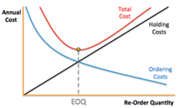
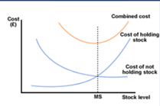
Unlocking Value through Smarter Stock Level Optimisation
The Value-based Model – an optimum solution, based on value, aligning engineering and finance.
The Value-based Model aligns engineering and finance by scientifically optimising spare parts parameters and the resulting service levels based on value. It does this by optimising stock levels (reorder quantities and reorder levels) by optimising the cost of holding spare parts vs. the cost of ordering them, while considering the probability and consequence of a stock-out. The approach applies consistently across the spare parts portfolio, including non-movers, operational spare parts, and consumables.
Value
Concern addressed
Recommended maximum and reorder points based on value, enabling Engineering and Finance to agree that stock levels are truly optimal.
Implementation of this solution generally delivers an internal rate of return (IRR) > 34% with minimal changes, implemented, while it jumps to 140% and higher if all the key recommendations are implemented.
More than optimised stock levels: clients gain insight into operational vulnerability and exposure across the plant.
Improved accuracy and confidence in lead-time values, based on verification against actual performance.
Obsolete spare parts are identified when mapping the consequences of a stockout.
Institutionalises tacit knowledge by formally linking equipment to spare parts, enabling faster response to emergency requests and reducing dependency on individual experience.
Finance and Operations clash over appropriate or, better yet, optimal stock levels. Are MRO spare parts levels sufficient to prevent costly downtime, or too high and simply tying up valuable capital?
Addressing obsolescent stock, but better even, creating the mechanism to identify it sustainably.
The risk of losing institutional knowledge when staff members leave or retire.
Emergency purchases and airfreight inflate costs.
Stores are packed with items, but the availability of the right spare part is still poor.
Key features
Optimum min–max levels set by optimising holding cost versus stock-out cost and consequence.
Demand forecasting with anomaly and peak filtering to improve signal quality.
Lead-time verification using actual lead-time performance.
Scenario simulation to test optimum policies and quantify worst-case stock-out consequences.
Exception management with “Top 10” purchase order review to prevent high-impact errors.
Identification of the top “x” optimisation opportunities for ongoing review and improvement.
Quantifies new optimisation opportunities and demonstrates the financial impact if implemented.
A
Demand Prediction Model
Spare Parts Optimisation Model
B
a. Optimum order quantity
b. Optimum service level

Slide 6
Unlocking Value through Smarter Implementation Support
Implementation support for ongoing sustainability and improvement. It’s not just about a once-off stock level optimisation.
Material management improvement is not a once-off exercise. It requires discipline and ongoing upkeep as assets, demand, and maintenance plans change. Even well-optimised stock levels degrade when processes and master data are not maintained, and new spare parts are added without consistent criticality, codification, and BoM alignment. Many organisations struggle to sustain this internally because it becomes ad hoc under operational pressure, accountability is unclear, and the CMMS/EAM system and material master data drift out of sync.
Implementation support: Not a once-off exercise, a sustained discipline driven by risk and consequence
Store process and maturity improvement: embed standards, controls, and ways of working that sustain performance.
Onboarding support for new projects: spare parts identification, specification, optimisation, and codification during commissioning and expansions.
Continuous optimisation (to an economically sensible level): prioritised improvement based on the Opportunity and Waste Analysis and ongoing performance signals.
Govern and maintain master data (BoMs, task links, codification, and criticality): keeping CMMS/EAM and the material master aligned so optimisation remains reliable.
Key features
Concerns addressed
On-site and/or off-site support to match operational needs and maturity.
Access to the material master and CMMS/EAM system, where the link between systems must be maintained (eg, BoMs and task links).
Ongoing optimisation cycles to prevent performance decay and respond to change.
Continuous upkeep of material master data to enable reliable planning and optimisation.
Reporting and management feedback to maintain visibility, governance, and accountability.
Sustainability of the solution — preventing drift after initial optimisation.
Ongoing improvement — maintaining momentum through structured review and execution.
Ad hoc labour requirements during commissioning — reducing scramble when new lines/assets require spare parts identification and optimisation.
Uncertainty on initial stocking — establishing justified order quantities instead of relying solely on OEM lists or conflicting internal opinions.
Criticality definition for new spare parts — ensuring service levels and stocking logic are set consistently.
Resolution of new spare parts issues — substitutes, interchangeability, and standardisation.
BoM development and support — keeping asset structures current and usable for planning.
Codification and standardisation — enabling control, re-use, and reduced duplication.
Sustained spare parts availability and cost control through embedded processes, governed data, and continuous optimisation.

Slide 7
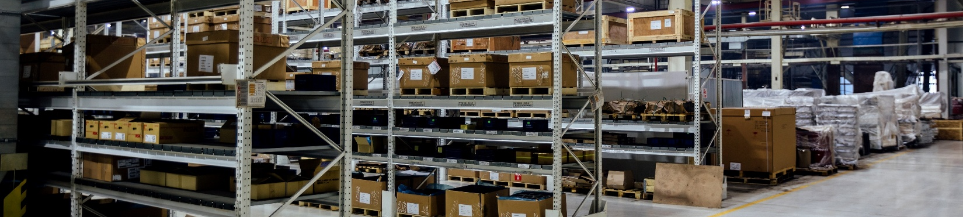
Unlocking Value through Smarter Spare Parts Management for Specific Industries
Optimised stock levels, less risk, more uptime.
Different industries face different operating realities - from lead times and supplier constraints to criticality, safety exposure, and the true cost of downtime. These differences must be built into the spare parts strategy, because a “one-size-fits-all” approach either overstocks low-risk items or leaves high-consequence equipment exposed. By tailoring spare parts decisions to each industry’s risk and demand profile, organisations achieve the optimal balance of spare parts availability, cost, and operational continuity.
Industry risks and how smarter spare parts management resolves them
Industry | Typical risks / issues without proper spare parts management | How proper spare parts management resolves these
Mining | Critical equipment, such as haul trucks or crushers, stands idle for days due to missing parts, the high cost of emergency air freight, and safety incidents caused by makeshift repairs. | Optimised spare parts planning ensures critical components (e.g., hydraulic pumps, crusher liners) are stocked at appropriate levels, reducing unplanned downtime and improving worker safety.
OEMs | Long lead times from global suppliers; disputes with clients over service level agreements (SLAs) when parts aren’t available; high warranty costs. | Classification and forecasting align stock with contractual service levels, ensuring OEMs meet SLA uptime commitments and reduce penalties while holding lower inventory.
Manufacturing | Production line stoppages due to missing low-cost but critical items like bearings, belts, or sensors; accumulation of obsolete stock from design changes. | Differentiated spare parts strategies (eg, “just-in-case” for critical items, vendor-managed for consumables) keep lines running smoothly while clearing obsolete stock to free up working capital.
Energy | Power plants face catastrophic downtime if turbines, transformers, or control systems fail without replacements on hand; spare parts often have long lead times. | Risk-based spare parts management ensures that “insurance spare parts” for critical components are maintained, while collaboration with suppliers shortens lead times and reduces overstocking of slow-moving items.

