Slide 1

Live OEE MEASUREMENT
Incorporating Digitisation in Asset Management
Notes:
Hello (thanks Kribban for the introduction) – today I will be discussing the topic of Live OOE Measurement .

Slide 2


What is OEE
OEE is simply stated as the calculation of the product of Availability, Performance and Quality.
In real world applications there is not always a simple way to get to these calculations as there are often perceived differences usually caused by different silos of views of the same issues.
Historical data may be recorded on paper based systems that are sometimes captured into excel sheets for analysis days, weeks or even months later.
A critical part of OEE is to standardize and agree the way that these values are measured and calculated across the organization.
Notes:
What is OEE -Overall Equipment Effectiveness. It is a factor that combines Availability, Performance and Quality -it is usually expressed as a percentage.
An OEE score of 100% means you are manufacturing only Good Parts, as fast as possible, with no Down Time. While 100% is the ideal score this number is merely a guide and many different goal numbers are often cited in reality and depending on the industry it varies greatly - Even starting from the 30’s .But the first step in using OEE is to calculate the OEE currently & then work on ways to improve it .
The other benefit of a standard OEE calculation is that we find in industry there are silos of data collection that exist in manufacturers on either paper based or excel based datasets inside plants typically these are grouped by Finance ,Production ,Quality and Maintenance .Each of these views leads to different versions of the truth . By utilizing an integrated platform with agreed OEE standards then a single version of the truth is developed and shared .

Slide 3




Live OEE Measurement
A MES system is an IT application which has the capability to extract process data from the production process with higher accuracy and granularity in real time than manual post process capturing does. A MES system can record the down times, capture quality loss data and monitoring the overall speed of production in real time.
Having this data collection as automated as possible helps to get a LIVE accurate calculation of OEE .It also helps management take faster and well-informed decisions pertaining to process capability, process performance, shift scheduling, employee/operator performance and process improvements.
As more of the data collection processes get automated more time and effort is saved in collecting and reporting data, this leads to better performance as the reaction time to issues is improved .
It also becomes easier to utilize the data and analytics to drill down to the exact cause of a performance related problem, as the data collected is allot more granular in nature than manual collection methods .
Notes:
How do we get data to perform a Live OEE measurement in a manufacturing environment ? Using a Manufacturing Execution Systems is normally the best way to digitally get live OEE data.MES solutions provide the ability to easily extract detailed granular information and highlight where issues may be occurring using analytics on the data .
A MES system can also be used to provide a corporate overview of performance of not just one plant, but multiple plants of the organization in real time. Allowing for comparisons on the performance across all the sites.By standardizing and data sharing across the enterprise this often highlights other areas of potential improvement .
Integrating the MES data with other systems such as EAMS and ERP create further insights into performance against planned performance and the status of the production processes .By analyzing's these integrated data sets it becomes easier to implement improvements to processes and procedures as well as to see trends and to set goals.
ROI of implementing a MES for Live OEE many different benefits can be achieved in different ways depending on where the client is on their digital path examples of these include :
-Basic automation of data collection vs manual data collection. Manual perceived measurements vs automated recorded measurements . Standardizing the OEE calculation and making the data available to all role players .
The best performing organizations have both operations and maintenance working as a team and MES allows both sets of data to be collected.
Continuous improvement –utilize the real time data and historic trends to plan ,implement and measure improvement projects.

Slide 4
Live OEE & The Six Big Losses
The Six Big Losses methodology was developed in Japan in the 1970 and modern use of this methodology ties OEE to the Total Productive Maintenance (TPM) approach. The six losses allow simple identification of equipment loss and specific procedures can be implemented to improve these . By improvement of any one of the six losses an improvement in OEE is seen . Live measurement of these enables continuous improvements.
The Six Big Losses are :
Equipment Failure
Setup & Adjustments
Idling & Minor Stops
Reduced Speed
Process Defects
Start-up Losses
Live measurement can be utilized to analyze down times and establish root causes of issues
Analyzing these and ensuring that standards are being followed and preventative maintenance done can lead to improvements in this
Live measurements can monitor progress to ensure that all are aware when planned downtime will occur to be more efficient during these times.ie product changeover times can be used for planned maintenance tasks
Use automation/HMI for capturing the cause–monitoring may lead to insights such as defective equipment that needs to be corrected .Or process issues causing increased rejects
By integrating these onto the HMI in a simple capture method the operators can capture these into the Live MES records
Live measurement can be utilized to display when the optimum speed is not being achieved allowing corrective actions to be taken
Notes:
Live OEE & The Six Big Losses-The Six Big Losses methodology was developed in Japan in the 1970 and modern use of this methodology ties OEE to the Total Productive Maintenance (TPM) approach .
OEE Availability losses:
1. Equipment failure, and unplanned downtime.
2. Setup and adjustments, or planned downtime .
OEE Performance losses:
3. Idling and minor stops .
4. Reduced speed.
OEE Quality losses:
5. Process defects and rework .
6. Start-up losses .
By focusing on improving these areas you will also improve the OEE score.

Slide 5

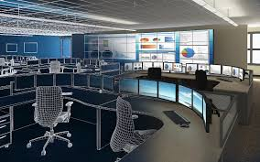


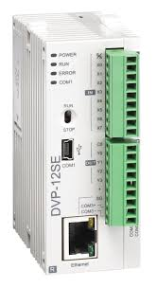
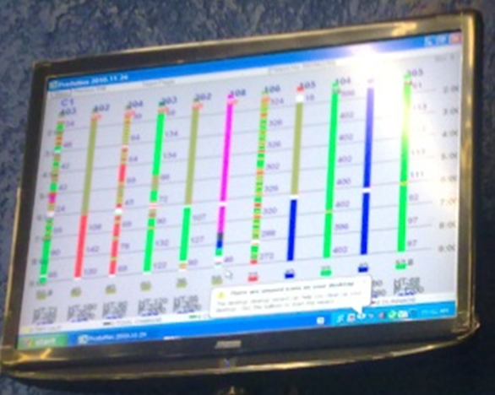
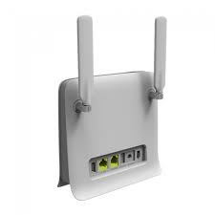

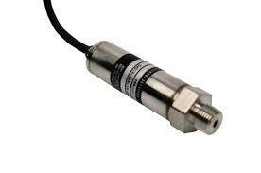
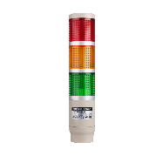

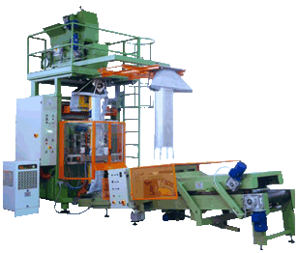
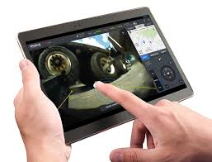
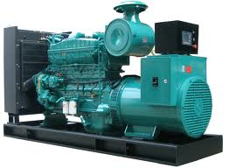
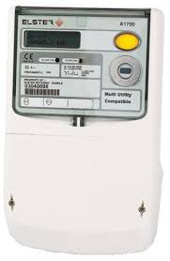
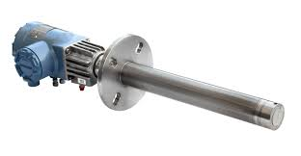

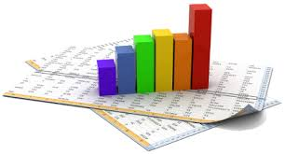
Overview Digitising Production Signals for Live OEE
Operational Displays
Dashboard Displays
Automation
PLCS
Operators & Managers PC
MES & Asset Server
Integration
Visual Performance Display Screens
PLC ‘s–Data Collection of Production. LED display status
WEB Interface
Wireless Router
Optional
Plant-Line A
EAMS
Mobile App
SMS Alerts
Email Alerts
Scheduled Reports
Generators
&
Fuel Level
PLC Pressure
&
Temperature
Power
Consumption
Billing
Stack Emission Sensors
Operator HMI
Ad Hoc Reports
Notes:
This slide gives an overview of the physical implementation of how production signals can be converted to digital format and integrated into an MES ,Asset Monitoring and EAMS system .
There is a an automation layer that connects on the production side using sensors on machinery that are connected to PLC’s . We also have indicated connections to the production service assets such as power meters and generators to record their status digitally in a Live asset monitoring system .
The PLC’s are link to the MES server that collects the data and stores it to a database . This data is then used for the various displays and alerts . The operators can see the status either on the light stack indicators ,displays or via the android HMI tablets .
Managers can see the status and OEE calculation on their PC ,mobile phone or displays .
Data from the MES and EAMS is integrated with integration data stores that allow data to be stored offline and then uploaded to the EAMS once connectivity is restored .The data inside the EAMS can then be used for analytics and live OEE dashboards and reporting.

Slide 6
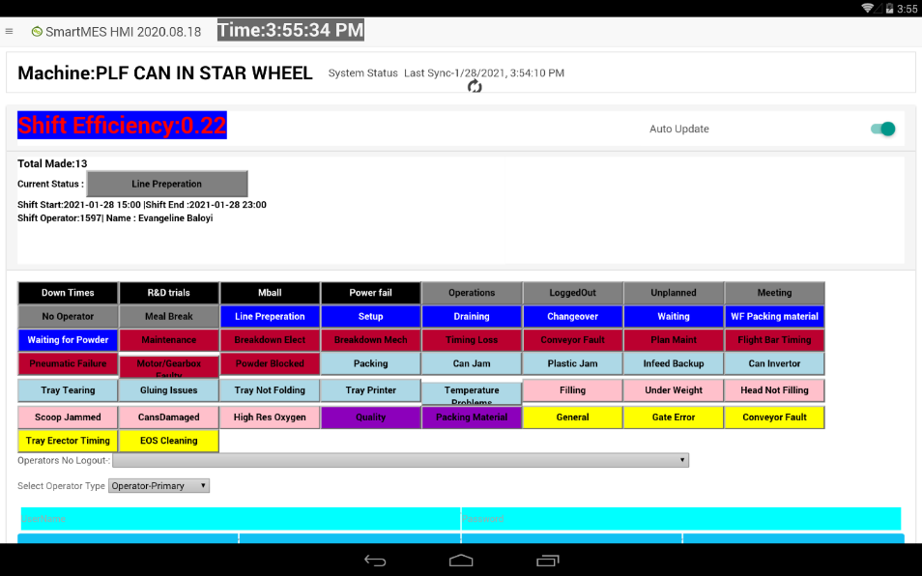
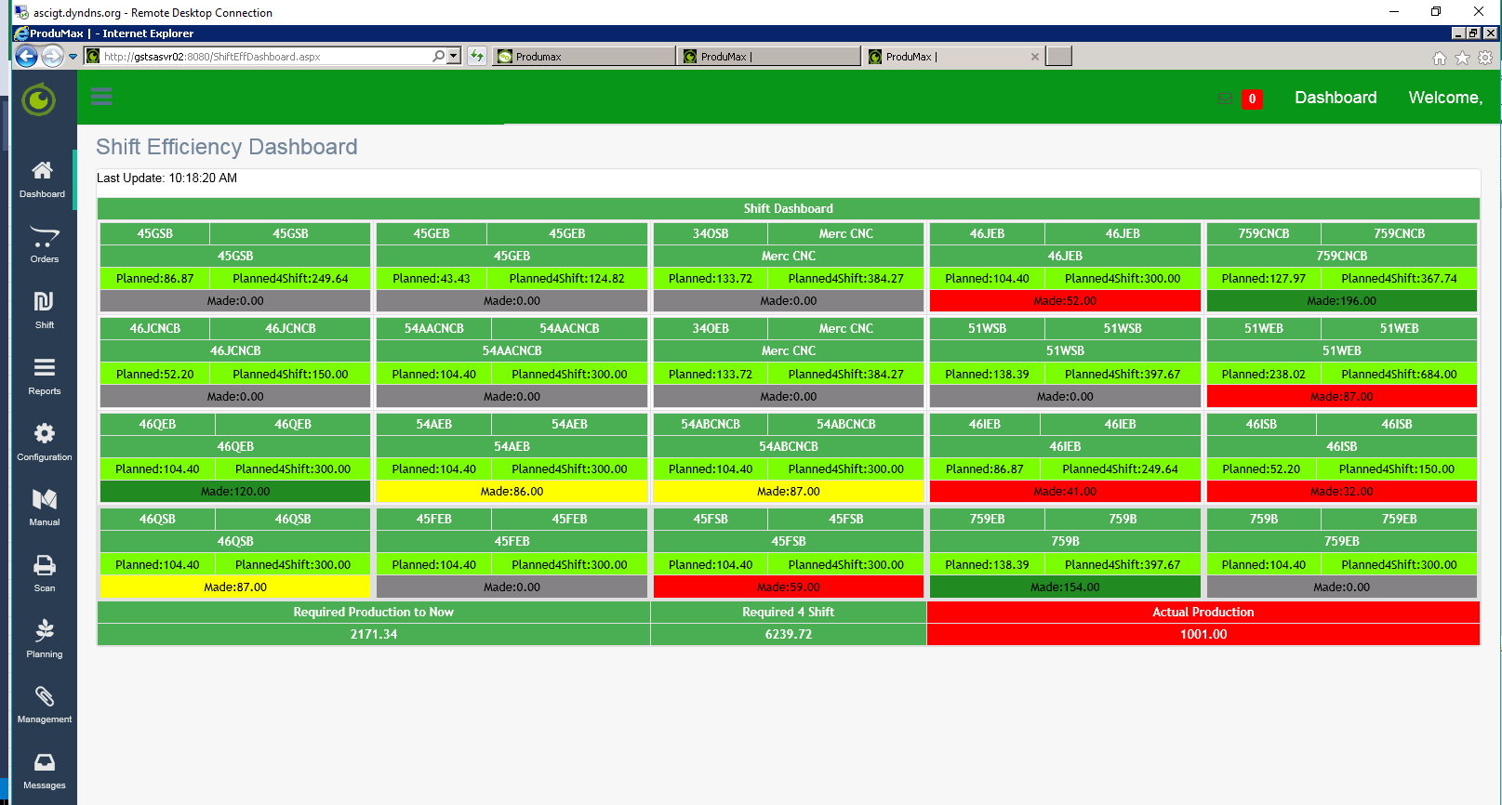
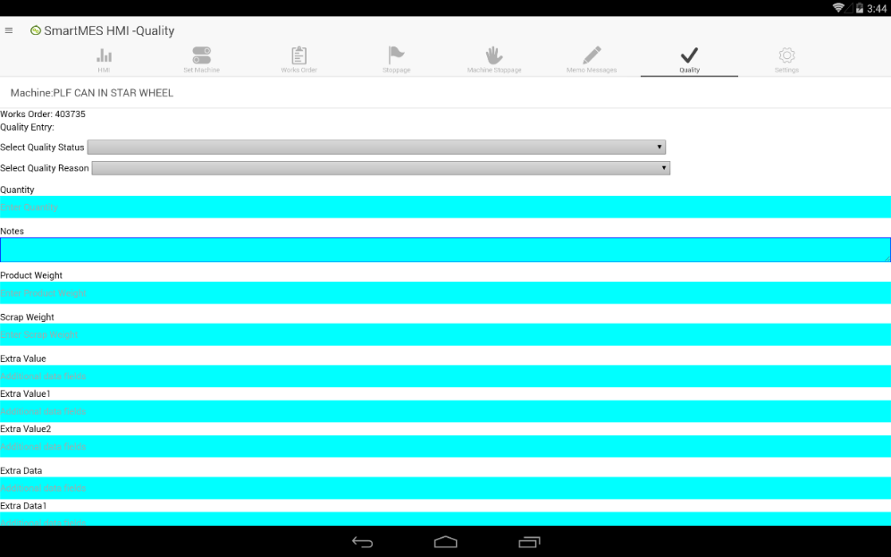
MES examples of Live OEE
Operator HMI using Android tablets allows for simple fast Downtime Selection.
Dashboards – Grey =Off .Green = Meeting Target . Yellow Bellow Target .Red = Missing Target
Android based Operator HMI allows for direct Quality capturing.
Notes:
Using various interfaces either web or mobile devices enables current status to be viewed and data easily captured at the source.
The HMI allows operators to quickly see their status and also enter downtime data
The Dashboard gives a quick view of the performance of the machinery against planned speeds
The Quality screen allows Quality operators to capture data on the shop floor as it occurs .

Slide 7
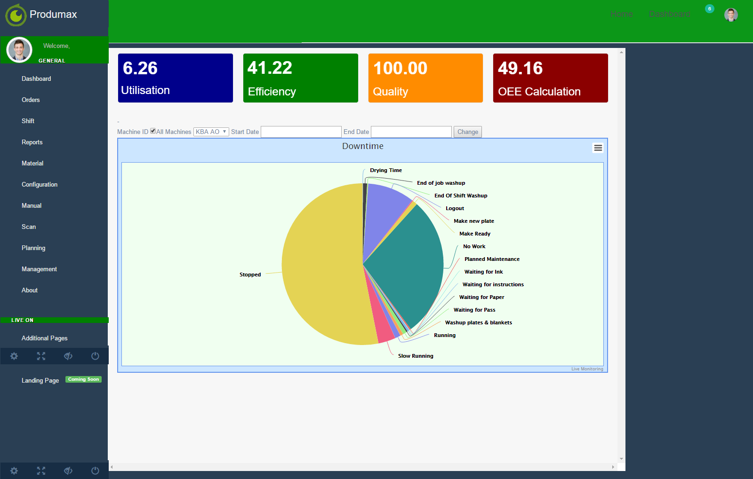
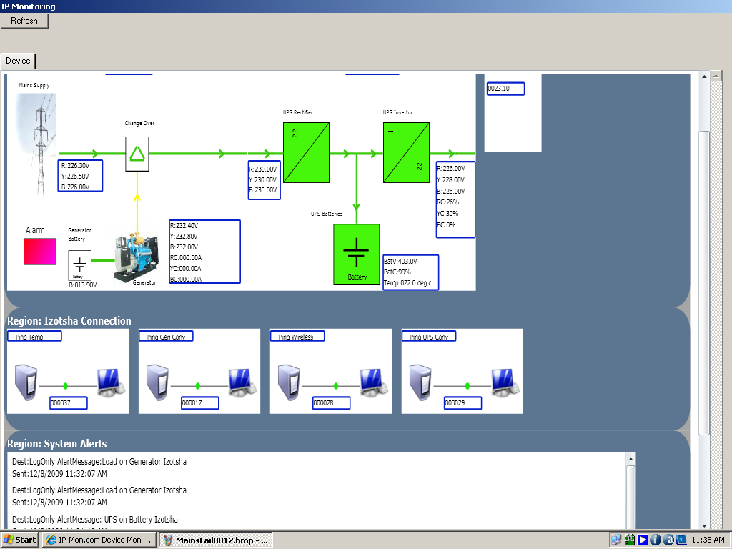
SmartMES Web based MES
Dashboard with OEE
Asset Status Screen
Notes:
An example screen of using a Dashboard for seeing the Live OEE calculation in a web based MES system and a live asset status display that assists with availability . At this site the Quality had not been captured yet (manual process) so it is shown as 100%.Utilisation is low as can be seen on the Pie graph of time .But efficiency when running was 41 percent.

Slide 8
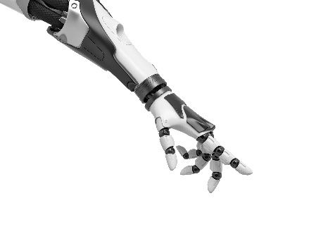

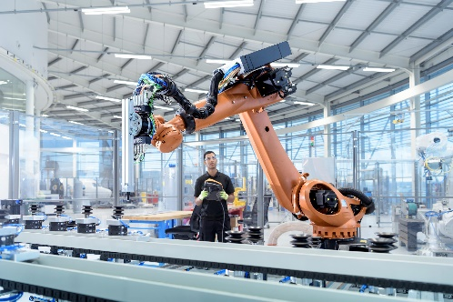
LIVE OEE and the future iot/iiot/4ir/…
The continued Automation of data gathering and sharing of information will become a key driver of industry efficiency and the way to measure this is still using OEE principals .
IOT and IIOT technologies makes gathering and sharing of this data simpler and more standardised . IIOT Connected smart anything's & client driven solutions are become more accessible .
Ability to use advance computer power on demand to predict trends using Machine learning , AI and advanced analytics by moving more data to the edge of the cloud and the cloud .
Meshed functionality with other systems including the use of Unified data spaces means systems sharing more information leads to further process improvements e.g. JIT manufacturers become aware of issues in supply chains before they impact their production schedule and can make arrangements to mitigate it . Using Meshed data sets often reveals hidden improvement areas .
In 2020 covid changed the global landscape most likely for a very long term and this impact was felt hugely in the manufacturing sector .
Key outcome of current changes are the ability to do more remotely with less physical contact. Anywhere operations became an overnight ideal. Key requirement is to make the data digital so that it can easily be viewed remotely .Distributed work force is now a reality where the Maintenance and Production management may not be onsite but will need accurate information on the production process status and issues .Be able to make planning and decisions on schedules and resources without physically seeing them .
Notes:
There are many new acronyms and new technology coming out .Every day we are presented with new tech announcements - Cloud ,IOT ,4IR ,4g ,LTE ,5G etc . The basis of most recent technology advances basically makes it easier to connect “things” to a digital world and record their status and produce knowledge based on the data they produce .Even us humans now have wearable sensors that are connected digitally to monitor and record data on our performance in our phones and watches . Some examples where these new technologies are making inroads in manufacturing are -: Miniature connected sensors either mounted by the OEM or added onto legacy assets collect streams of data on performance of motors and components that were previously not able to be monitored . The use of AI to analyse this data collected is showing areas for improvements. Analytics and predictive analytics using the AI technology are improving machine availability . The digital connected asset and related components as part of the Live OEE measurement is becoming easier to implement. Current drivers to digitise -The last year of lockdowns and Covid has highlighted the need to digitise the data collection of various processes and statuses to allow for easier remote management and accurate production status information .

